Slide 1
Computer Architecture
System Software Crash Course

Slide 2
Agenda
Computer architecture
CPU Architecture

Slide 3
Computer Architecture

Slide 4

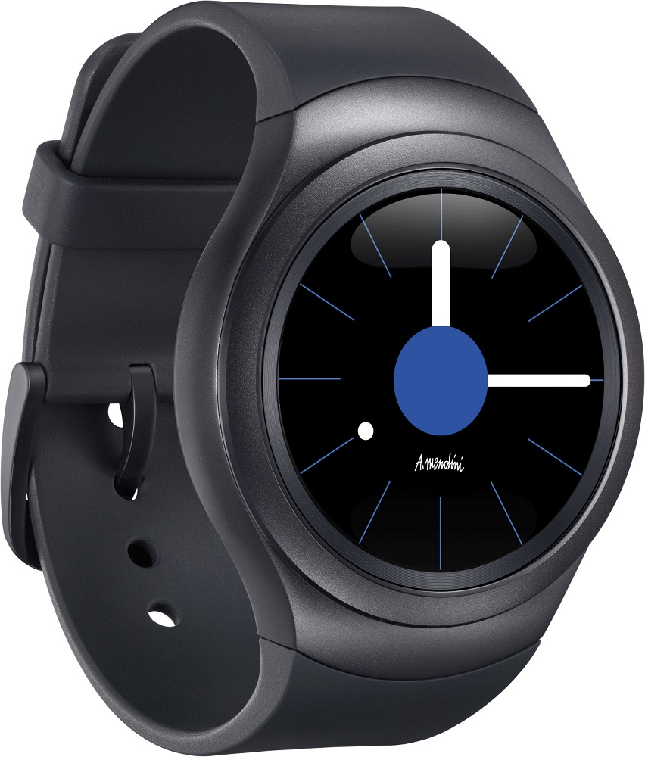



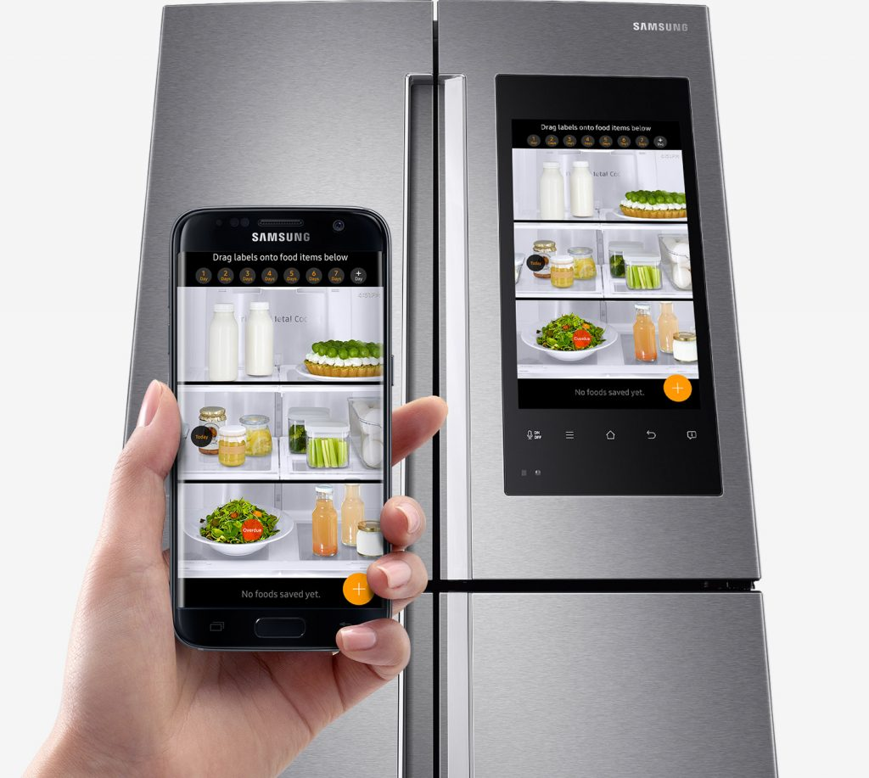

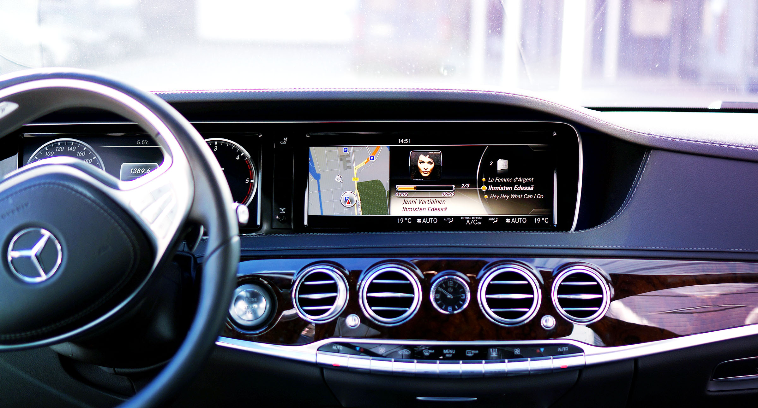
Computers in Our Life

Slide 5
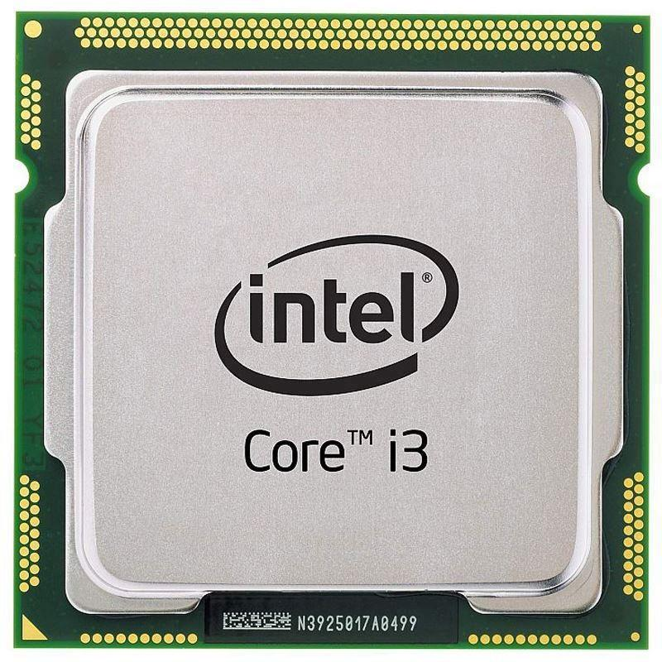
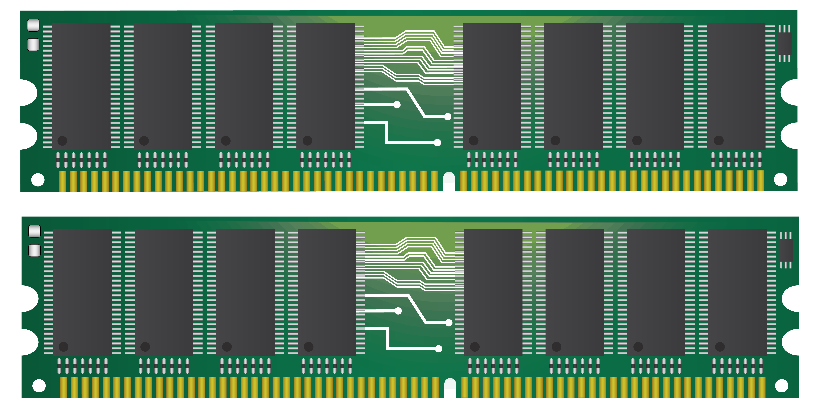
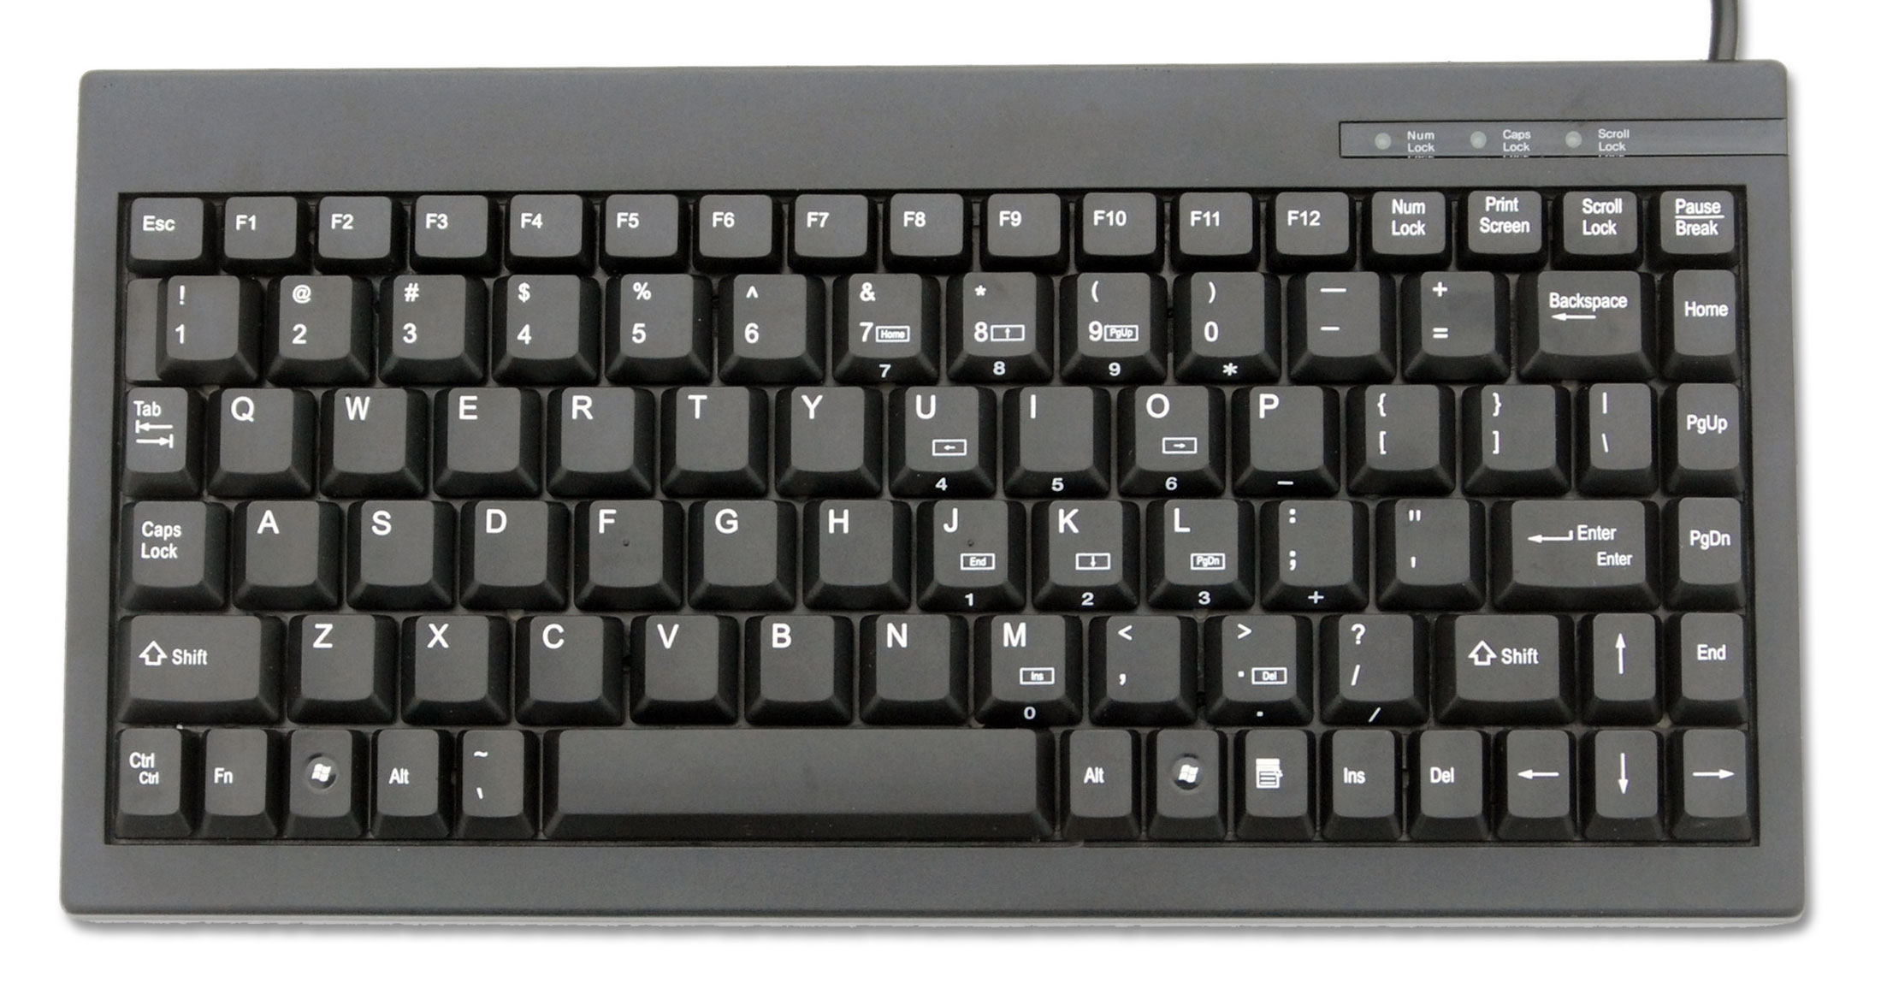

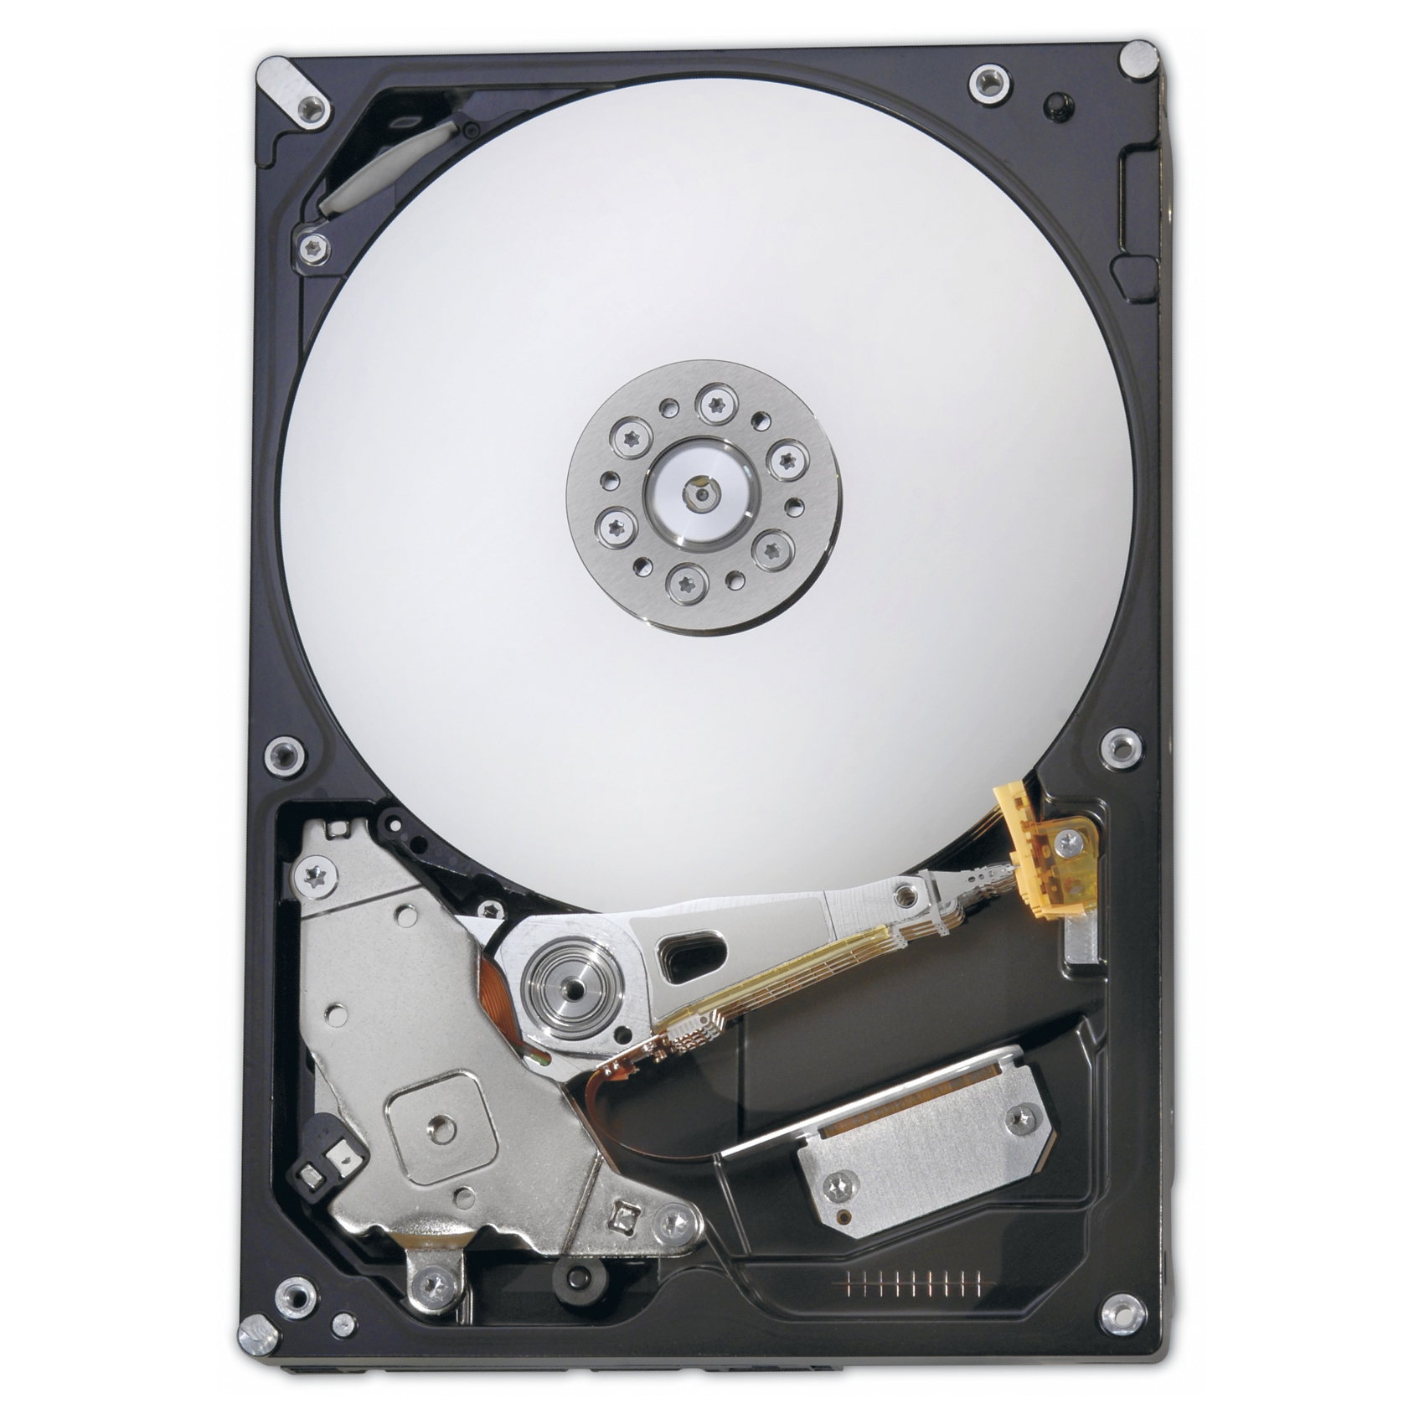
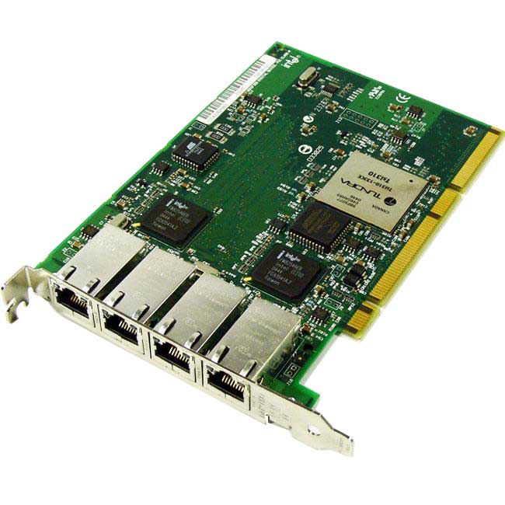

Computer Organization

Slide 6
Instruction Set Architecture
The words of a computer’s language are called instructions, and its vocabulary is called Instruction Set.
The Instruction Set Architecture is a abstract model of computer, it serves as the interface between software and hardware.
The ISA is based on idea of stored program: instructions and data can be stored in memory as numbers.
The goal for ISA design: find a language that makes it easy to build hardware and compiler while maximizing performance and minimizing cost and energy consumption.
In general ISA defines supported data types, state (main memory, registers), instructions and input/output model.

Slide 7
Instruction Set Architecture
Arithmetic and logic instructions:
Add, subtract, multiply, divide, increment, decrement;
Bitwise operations: bitwise and, bitwise or, bitwise exclusive or, negation, shifts;
Comparison: equal, not equal, less, greater, less or equal, greater or equal, comparison to zero;
Floating-point arithmetic and comparison.
Data handling:
Copy data to or from register or memory (also loading and storing);
Set a register to fixed value;
Read or write hardware device.
Control flow:
Jump to another program location;
Conditionally branch to another location;
Indirectly branch to another location;
Call another procedure saving next instruction pointer.

Slide 8
Addressing Modes
An addressing mode specifies how to calculate the effective memory address of an operand by using information contained within a machine instruction
Addressing modes for code:
Sequential execution: EA = next instruction address
Absolute or direct: EA is address parameter itself
PC-relative: EA = next instruction address + offset parameter
Register indirect: EA = contents of a register

Slide 9
Addressing Modes
Addressing modes for data:
Implicit: implied by operation code
Immediate: value of operand is held within instruction itself
Register: value is held in a register
Absolute or direct: EA is an address parameter
Based: EA = content of a register + value of immediate operand
Register indirect: EA = contents of a register
Based with index: EA = contents of base register + contents of index register + value of immediate operand
Scaled: EA = contents of a register * scale + value of immediate operand
Autoincrement: EA = content of a register; register is incremented

Slide 10
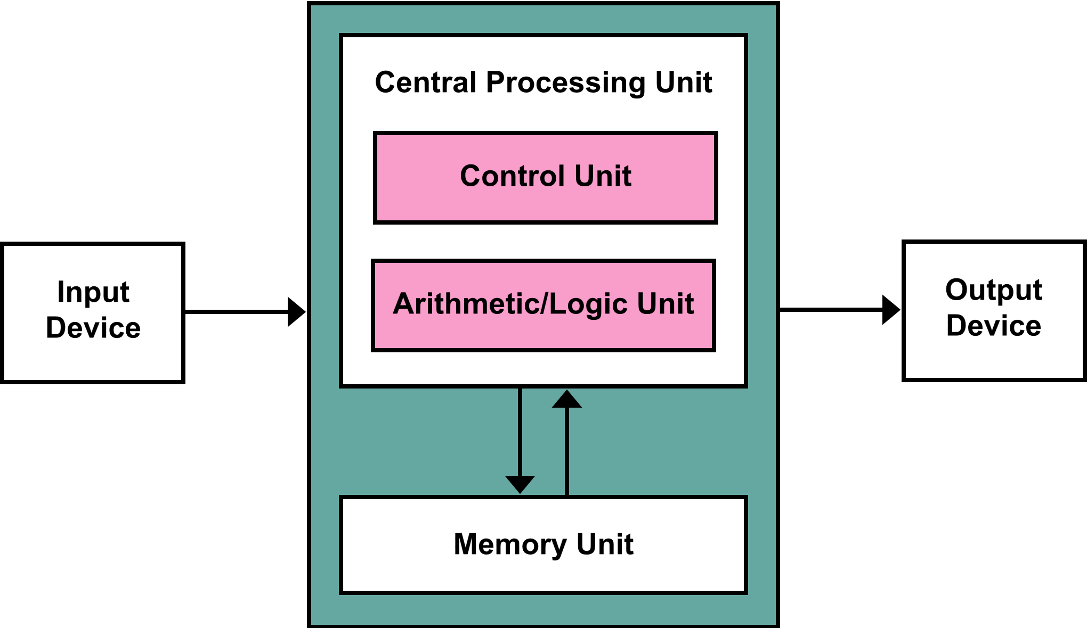
Von Neumann Architecture
Von Neumann architecture is based on stored program concept.
Allows program tooling: programs that write programs.
Von Neumann bottleneck: limited throughput between CPU and memory.

Slide 11
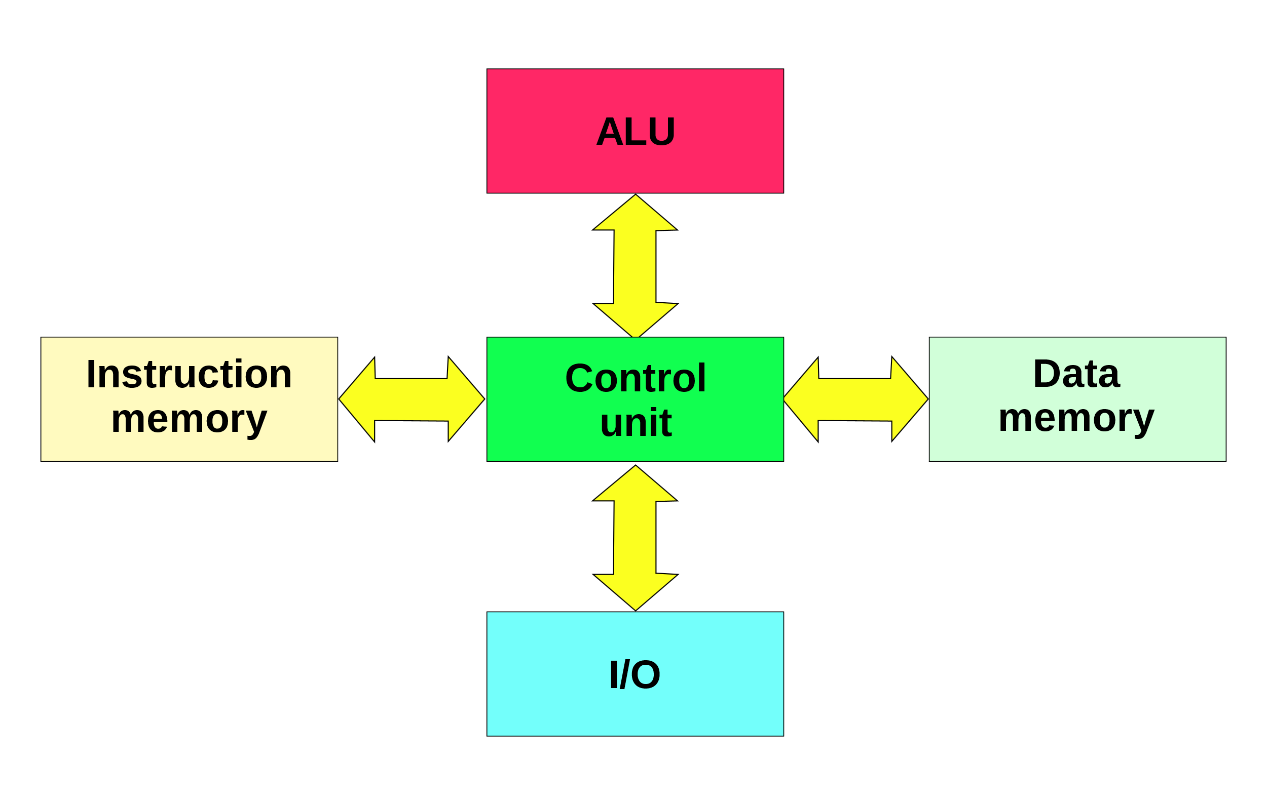
Harvard
Harvard architecture physically separates data and instruction memory.
Overcome von Neumann bottleneck
Increased cost of hardware

Slide 12
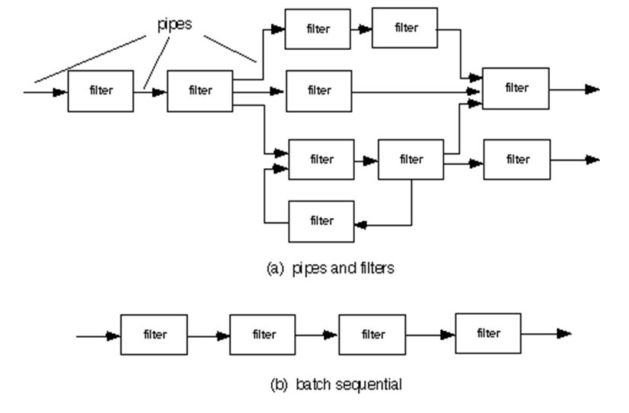
Data Flow
Dataflow architectures do not have a program counter, the executability and execution of instructions is solely determined based on the availability of input arguments to the instructions

Slide 13
CPU Architecture

Slide 14
Central Processing Unit
Control
Fetch
Decode
ALU
Memory
Registers
PC
Write

Slide 15
CPU Cycle
Control
Fetch
Decode
ALU
Memory
Registers
PC
Write

Slide 16
CPU Cycle
 | 1 | 2 | 3 | 4 | 5 | 6 | 7 | 8 | 9 | 10 | 11
LOAD | Fetch | Decode | Execute | Memory | Write
LOAD |  |  |  |  |  | Fetch | Decode | Execute | Memory | Write
ADD |  |  |  |  |  |  |  |  |  |  | Fetch

Slide 17
Pipeline
 | 1 | 2 | 3 | 4 | 5 | 6 | 7
LOAD | Fetch | Decode | Execute | Memory | Write
LOAD |  | Fetch | Decode | Execute | Memory | Write
ADD |  |  | Fetch | Decode | Execute | Memory | Write

Slide 18
Pipelined Central Processing Unit
Control
Fetch
ALU
Memory
Decode
Registers
PC
Write

Slide 19
Reduced Instruction Set Computer
Pipelined execution unit.
Load/store based ISA: operations only on registers.
Simple addressing modes.
Large register file.
Three-operands instructions.
Separated instruction and data caches.

Slide 20
Pipeline Advantages & Hazards
Advantages
Asymptotic performance 1 operation per cycle
Reduced hardware complexity
Hazards
Structural hazards
Data hazards
Control hazards

Slide 21
Structural Hazards
Planned instruction cannot execute because the hardware does not support the combination of instructions.
 | 1 | 2 | 3 | 4 | 5 | 6 | 7
LOAD | Fetch | Decode | Execute | Memory | Write
LOAD |  | Fetch | Decode | Execute | Memory | Write
ADD |  |  | Fetch | Decode | Execute | Memory | Write
STORE |  |  |  |  | Fetch | Decode | Execute

Slide 22
Data Hazards
Pipeline must be stalled because one step must wait another to complete
 | 1 | 2 | 3 | 4 | 5
ADD R0, R1, R2 | Fetch | Decode | Execute | Write
SUB R3, R0, R4 |  | Fetch | Decode | Execute | Write
 | 1 | 2 | 3 | 4 | 5 | 6 | 7
LOAD R0, R1(20) | Fetch | Decode | Execute | Memory | Write
SUB R3, R0, R4 |  | Fetch | Decode | Stall | Stall | Execute | Write

Slide 23
Control Hazards
The control hazard arises when CPU needs to make decision based on the result of one instruction while executing others
 | 1 | 2 | 3 | 4 | 5 | 6 | 7
ADD R4, R5, R6 | Fetch | Decode | Execute | Memory | Write
BEQ R4, R2, 40 |  | Fetch | Decode | Execute | Memory | Write
LOAD R3, 30(R0) |  |  | Fetch | Decode | Execute | Memory | Write
 | 1 | 2 | 3 | 4 | 5 | 6 | 7
ADD R4, R5, R6 | Fetch | Decode | Execute | Memory | Write
BEQ R4, R2, 40 |  | Fetch | Decode | Execute | Memory | Write
OR R7, R8, R9 |  |  | Stall | Stall | Stall | Fetch | Decode

Slide 24
Forwarding
Stalling on data hazards reduces performance of CPU.
Forwarding: delivering result of a later pipeline stage to earlier one.
Increase complexity of the hardware:
One need data dependency detection logic
One need data forwarding logic
Compiler should re-arrange instructions to achieve maximal performance

Slide 25
Branch Prediction
Control hazards handling strategies:
Assume branch not taken
Reduce the delay of branches
Likely / unlikely branch instructions
Dynamic branch prediction
Not Taken
Predict taken
Predict taken
Taken
Taken
Not Taken
Taken
Not Taken
Predict not taken
Predict not taken
Not Taken
Taken

Slide 26
Thank you!

